Slide 1
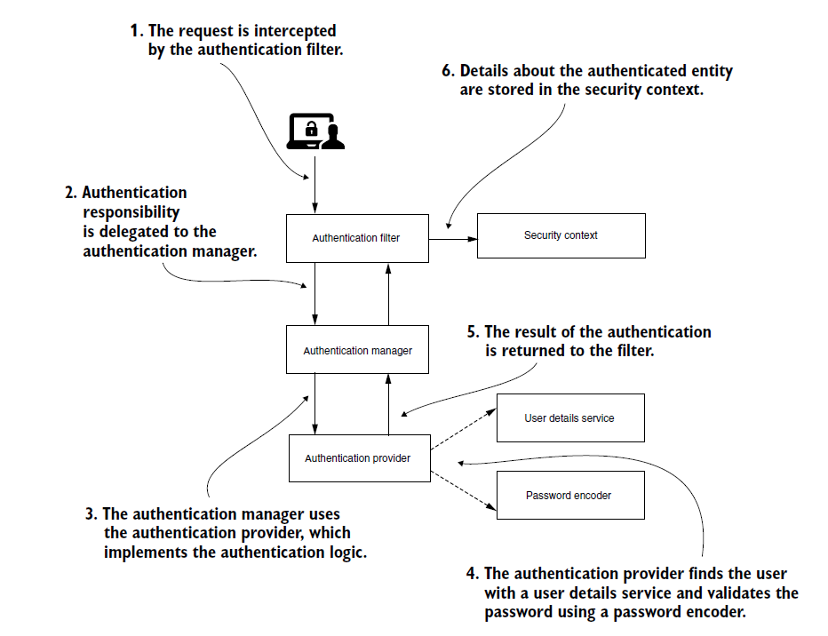
Архитектура SPRING SECURITY

Slide 2
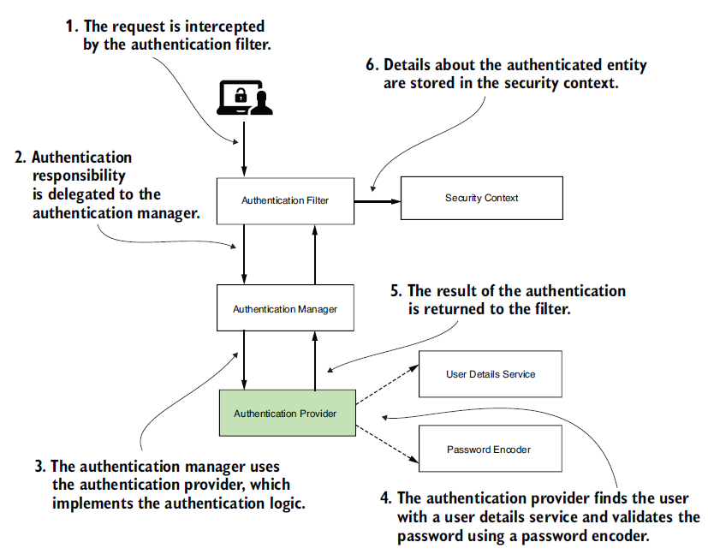
Провайдер аутентификации
@Component
public class CustomAuthenticationProvider
➥implements AuthenticationProvider {
@Override
public Authentication authenticate
➥(Authentication authentication) throws AuthenticationException {
// authentication logic here
}
@Override
public boolean supports(Class<?> authenticationType) {
// type of the Authentication implementation here
}
}

Slide 3
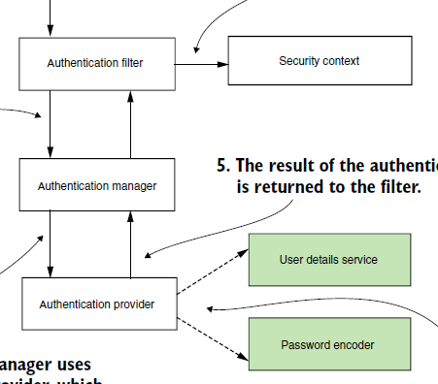
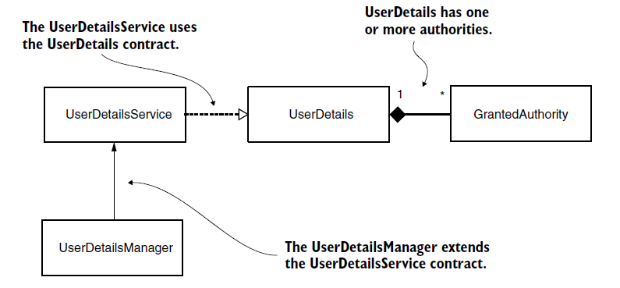
Служба сведений о пользователе

Slide 4
User Details
public interface UserDetails extends Serializable {
String getUsername();
String getPassword();
Collection<? extends GrantedAuthority>
➥getAuthorities();
boolean isAccountNonExpired();
boolean isAccountNonLocked();
boolean isCredentialsNonExpired();
boolean isEnabled();
}

Slide 5
Granted Authority
public interface GrantedAuthority extends Serializable {
String getAuthority();
}

Slide 6
User example
public class User implements UserDetails {
private final String username;
private final String password;
private final String authority;
public User(String username, String password, String authority) {Some code}
@Override
public Collection<? extends GrantedAuthority> getAuthorities() {return List.of(() -> authority);}
@Override
public String getPassword() {return password;}
@Override
public String getUsername() {return username;}
@Override
public boolean isAccountNonExpired() {return true;}
@Override
public boolean isAccountNonLocked() {return true;}
@Override
public boolean isCredentialsNonExpired() {return true;}
@Override
public boolean isEnabled() {return true;}
}

Slide 7
User Details Service
public interface UserDetailsService {
UserDetails loadUserByUsername(String username)
throws UsernameNotFoundException;
}

Slide 8
User Details Manager
public interface UserDetailsManager extends UserDetailsService {
void createUser(UserDetails user);
void updateUser(UserDetails user);
void deleteUser(String username);
void changePassword(String oldPassword, String newPassword);
boolean userExists(String username);
}

Slide 9
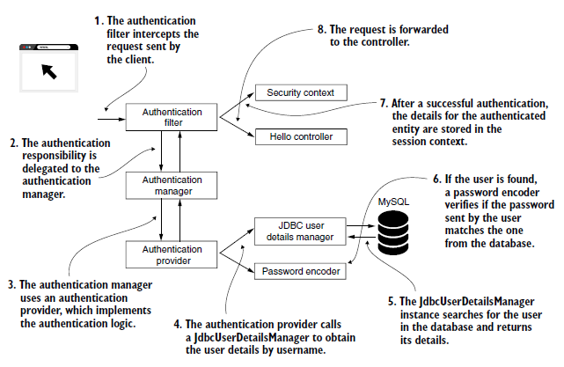
Архитектура SPRING SECURITY

Slide 10
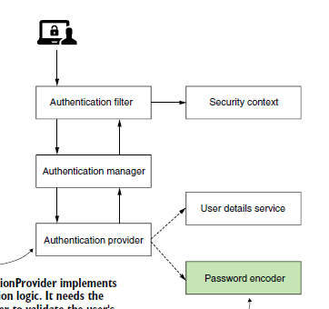
Кодировщик паролей
public interface PasswordEncoder {
String encode(CharSequence rawPassword);
boolean matches(CharSequence rawPassword, String encodedPassword);
default boolean upgradeEncoding(String encodedPassword) {return false;}
}

Slide 11
Кодировщик паролей
public class Sha512PasswordEncoder
implements PasswordEncoder {
@Override
public String encode(CharSequence rawPassword) {
return hashWithSHA512(rawPassword.toString());
}
@Override
public boolean matches(
CharSequence rawPassword, String encodedPassword) {
String hashedPassword = encode(rawPassword);
return encodedPassword.equals(hashedPassword);
}
// Omitted code
}

Slide 12
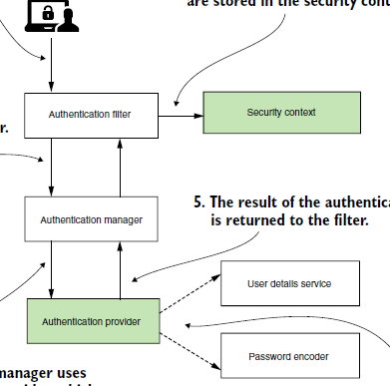
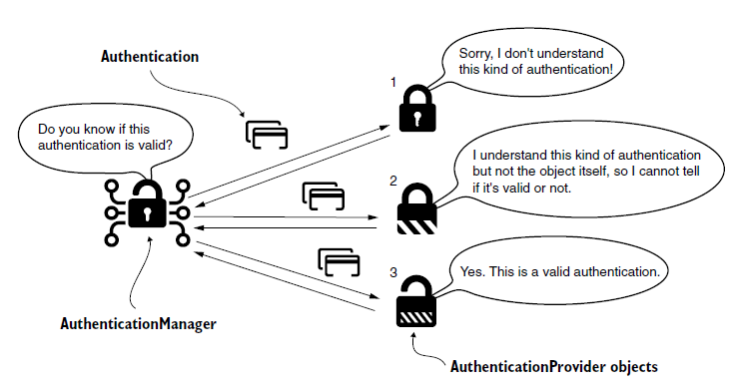
Многофакторная защита контекст безопасности

Slide 13
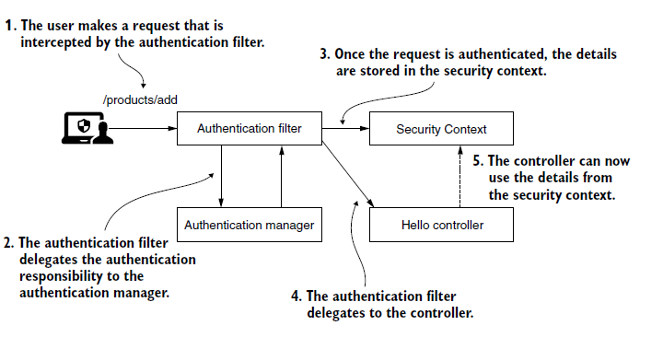
Архитектура SPRING SECURITY

Slide 14
Архитектура SPRING SECURITY
public interface SecurityContext extends Serializable {
Authentication getAuthentication();
void setAuthentication(Authentication authentication);
}

Slide 15
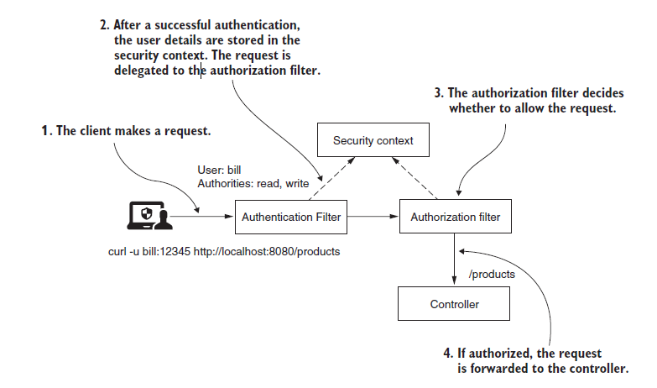
Архитектура SPRING SECURITY

Slide 16
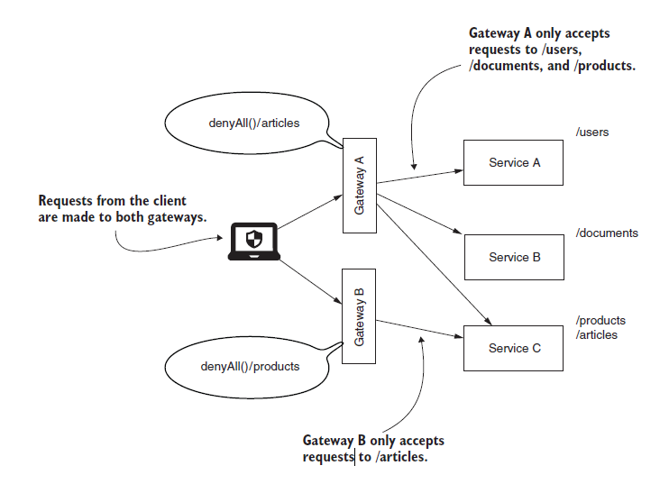
Архитектура SPRING SECURITY

Slide 17
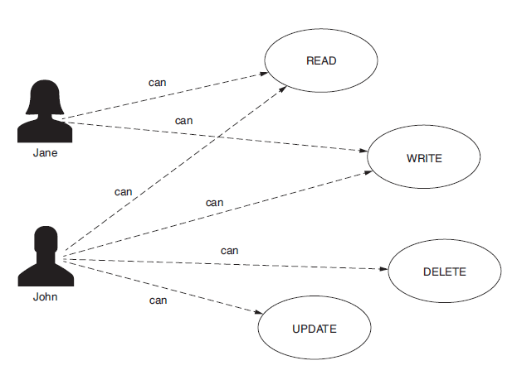
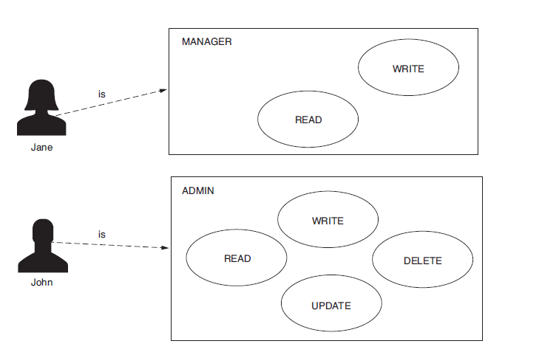
Архитектура SPRING SECURITY

